Slide 1

Bijan Paul
Senior Lecturer
East West University
Notes:
Anyone already familiar with HTML?
Disclaimer: I do not work in HTML very often.

Slide 2
  An unordered list starts with the <ul> tag. Each list item starts with the <li> tag.
  The list items will be marked with bullets (small black circles) by default
Unordered HTML List - Choose List Item Marker
    The CSS list-style-type property is used to define the style of the list item marker
Value | Description
disc | Sets the list item marker to a bullet (default)
circle | Sets the list item marker to a circle
square | Sets the list item marker to a square
none | The list items will not be marked

Slide 3
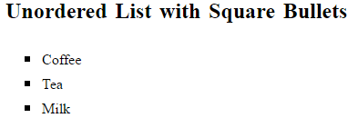
<!DOCTYPE html>
<html>
<body>
<h2>Unordered List with Square Bullets</h2>
<ul style="list-style-type: square">
<li>Coffee</li>
<li>Tea</li>
<li>Milk</li>
</ul>
</body>
</html>

Slide 4
  An ordered list starts with the <ol> tag. Each list item starts with the <li> tag.
  The list items will be marked with numbers by default
Ordered HTML List - The Type Attribute
    The type attribute of the <ol> tag, defines the type of the list item marker
Type | Description
type="1" | The list items will be numbered with numbers (default)
type="A" | The list items will be numbered with uppercase letters
type="a" | The list items will be numbered with lowercase letters
type="I" | The list items will be numbered with uppercase roman numbers
type="i" | The list items will be numbered with lowercase roman numbers

Slide 5
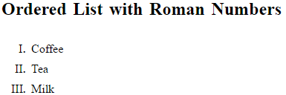
<!DOCTYPE html>
<html>
<body>
<h2>Ordered List with Roman Numbers</h2>
<ol type="I">
<li>Coffee</li>
<li>Tea</li>
<li>Milk</li>
</ol>
</body>
</html>

Slide 6
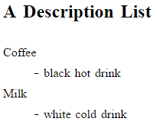
HTML also supports description lists.
A description list is a list of terms, with a description of each term.
The <dl> tag defines the description list, the <dt> tag defines the term (name), and the <dd> tag describes each term
Example
<!DOCTYPE html>
<html>
<body>
<h2>A Description List</h2>
<dl>
<dt>Coffee</dt>
<dd>- black hot drink</dd>
<dt>Milk</dt>
<dd>- white cold drink</dd>
</dl>
</body>
</html>

Slide 7
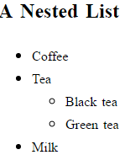
<!DOCTYPE html>
<html>
<body>
<h2>A Nested List</h2>
<ul>
<li>Coffee</li>
<li>Tea
<ul>
<li>Black tea</li>
<li>Green tea</li>
</ul>
</li>
<li>Milk</li>
</ul>
</body>
</html>

Slide 8
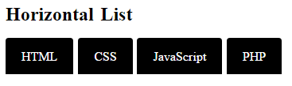
<!DOCTYPE html>
<html>
<head>
<style>
ul#menu {
padding: 0;
}
ul#menu li {
display: inline;
}
ul#menu li a {
background-color: black;
color: white;
padding: 10px 20px;
text-decoration: none;
border-radius: 4px 4px 0 0;
}
ul#menu li a:hover {
background-color: orange;
}
</style>
</head>
<body>
<h2>Horizontal List</h2>
<ul id="menu">
<li><a href="#HTML">HTML</a></li>
<li><a href="#CSS">CSS</a></li>
<li><a href="#JAVASCRIPT">JavaScript</a></li>
<li><a href="#PHP">PHP</a></li>
</ul>
</body>
</html>

Slide 9
Block-level Elements
  A block-level element always starts on a new line and takes up the full width available (stretches out to the left and right as far as it can).
  The <div> element is a block-level element.
  Examples of block-level elements:
      <div>
      <h1> - <h6>
      <p>
      <form>
Inline Elements
  An inline element does not start on a new line and only takes up as much width as necessary.
  This is an inline <span> element inside a paragraph.
  Examples of inline elements:
    <span>
    <a>
    <img>

Slide 10
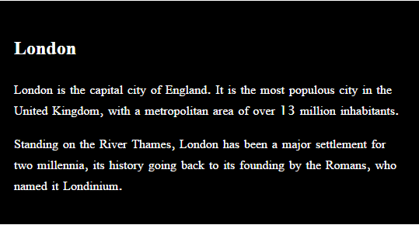
The <div> element is often used as a container for other HTML elements.
The <div> element has no required attributes, but both style and class are common.
When used together with CSS, the <div> element can be used to style blocks of content
Example
<!DOCTYPE html>
<html>
<body>
<div style="background-color:black;color:white;padding:20px;">
<h2>London</h2>
<p>London is the capital city of England. It is the most populous city in the United Kingdom, with a metropolitan area of over 13 million inhabitants.</p>
<p>Standing on the River Thames, London has been a major settlement for two millennia, its history going back to its founding by the Romans, who named it Londinium.</p>
</div>
</body>
</html>

Slide 11
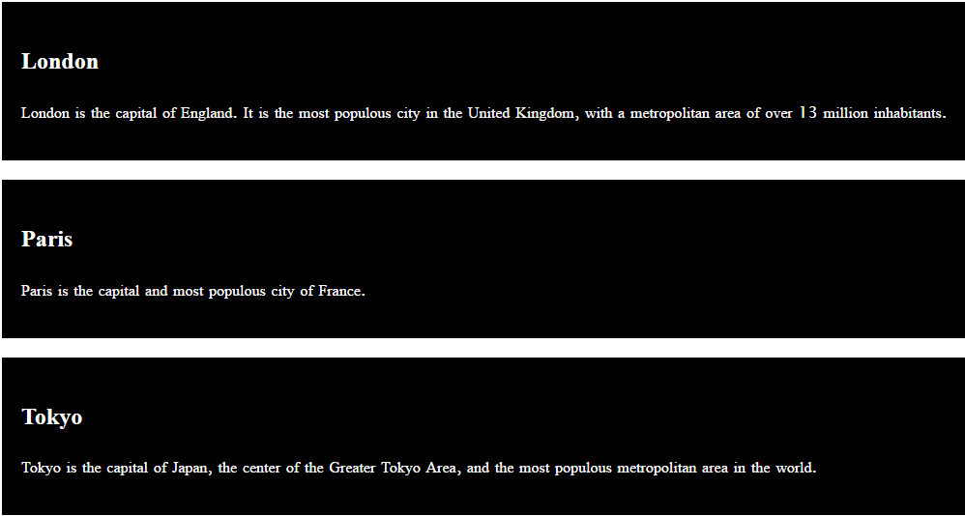
The HTML class attribute makes it possible to define equal styles for elements with the same class name.
Example
<!DOCTYPE html>
<html>
<head>
<style>
div.cities {
background-color: black;
color: white;
margin: 20px 0 20px 0;
padding: 20px;
}
</style>
</head>
<body>
<div class="cities">
<h2>London</h2>
<p>London is the capital of England. It is the most populous city in the United Kingdom, with a metropolitan area of over 13 million inhabitants.</p>
</div>
<div class="cities">
<h2>Paris</h2>
<p>Paris is the capital and most populous city of France.</p>
</div>
<div class="cities">
<h2>Tokyo</h2>
<p>Tokyo is the capital of Japan, the center of the Greater Tokyo Area, and the most populous metropolitan area in the world.</p>
</div>
</body>
</html>

Slide 12
To play an audio file in HTML, use the <audio> element
The controls attribute adds audio controls, like play, pause, and volume.
The <source> element allows you to specify alternative audio files which the browser may choose from. The browser will use the first recognized format.
EXAMPLE
<!doctype html>
<html>
<head>
</head>
<body>
<audio controls="audiocontrols">
<source src="music.mp3"/>
<source src="music.wav"/>
</audio>
<!-- Three standard formats for web browsers are .mp3 .wav -->
</body>
</html>

Slide 13
To show a video in HTML, use the <video> element
The controls attribute adds video controls, like play, pause, and volume.
It is a good idea to always include width and height attributes.
The <source> element allows you to specify alternative video files which the browser may choose from. The browser will use the first recognized format.
EXAMPLE
<!doctype html>
<html>
<head>
</head>
<body>
<video width="640" height="360" controls>
<source src="scientist.mp4"/>
<source src="scientist.wmv"/>
</video>
<!-- Standard video formats for web browsers are .mp4, wmv -->
</body>
</html>

Slide 14
An HTML marquee is a scrolling piece of text displayed either horizontally across or vertically down your webpage depending on the settings. This is created by using HTML <marquees> tag.
Example
<!DOCTYPE html>
<html>
<head>
<title>HTML marquee Tag</title>
</head>
<body>
<marquee>This is basic example of marquee</marquee>
</body>
</html>

Slide 15
HTML frames are used to divide your browser window into multiple sections where each section can load a separate HTML document.
A collection of frames in the browser window is known as a frameset.
The <frameset> tag defines how to divide the window into frames. The rows attribute of <frameset> tag defines horizontal frames and cols attribute defines vertical frames.
Each frame is indicated by <frame> tag and it defines which HTML document shall open into the frame.
Example:
14.Frames in HTML

Slide 16
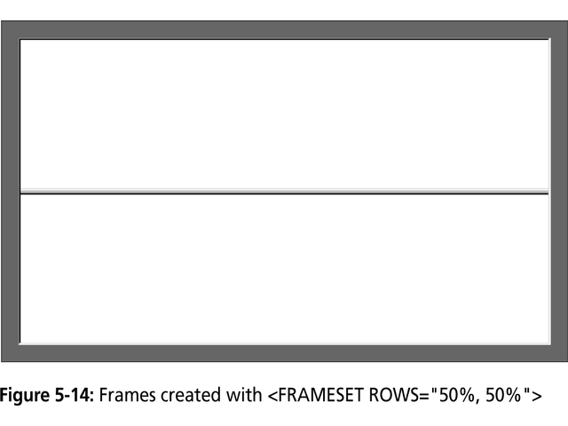

Slide 17
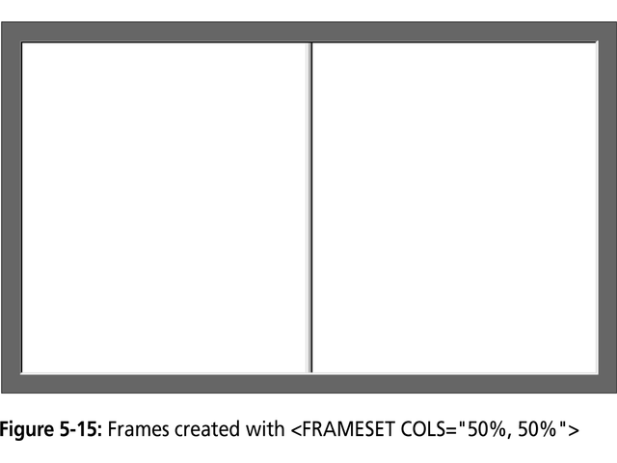

Slide 18
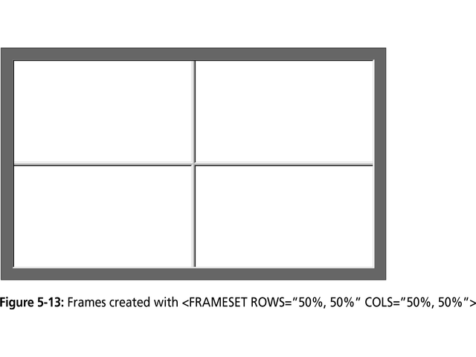

Slide 19
An iframe is used to display a web page within a web page.
The <iframe> tag defines a rectangular region within the document in which the browser can display a separate document, including scrollbars and borders.
An HTML iframe is defined with the <iframe> tag:
  <iframe src="URL"></iframe>
The src attribute specifies the URL (web address) of the inline frame page.
Iframe - Set Height and Width
  Use the height and width attributes to specify the size of the iframe.
Example
15.IFrame Example

Slide 20

https://www.w3schools.com/html/default.asp
http://www.tutorialspoint.com/html/

